Slide 1
Food Stamps (SNAP) and Nutrition Programs Prof. Mark Shepard Special Guest: Kelsey Pukelis Harvard Kennedy School SUP-110: Poverty and Public Policy Spring 2025, Week 6

Slide 2
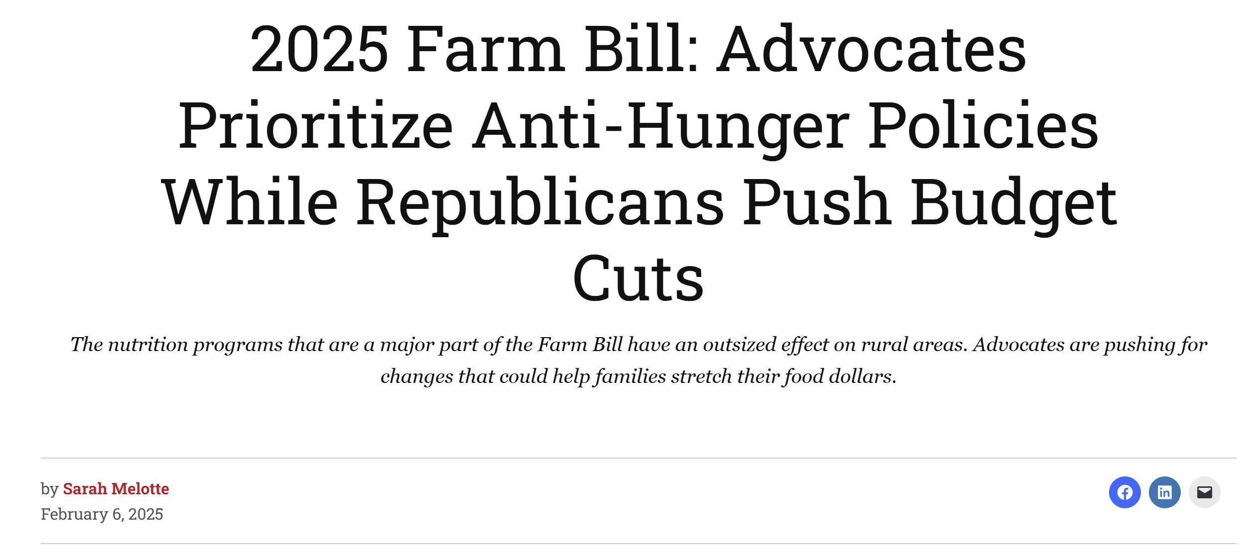
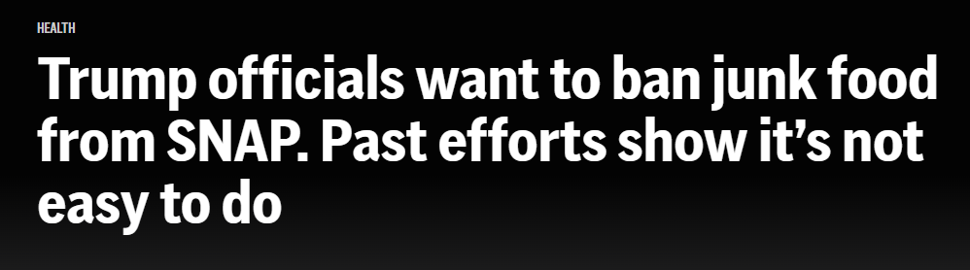
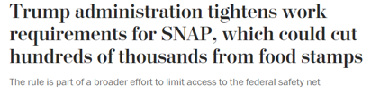
Motivation: Policy debates on food assistance
Notes:
https://apnews.com/article/snap-cuts-candy-soda-food-stamps-b6351b86a17b281b67480fe2d24b54f4
Excluding any foods would require Congress to change the law — or for states to get waivers that would let them restrict purchases, said Katie Bergh, a senior policy analyst for the Center on Budget and Policy Priorities, a nonpartisan research group. Over the past 20 years, lawmakers in several states have proposed stopping SNAP from paying for bottled water, soda, chips, ice cream, decorated cakes and “luxury meats” like steak.
….
In the past, Agriculture Department officials rejected the waivers, saying in a 2007 paper that no clear standards exist to define foods “as good or bad, or healthy or not healthy.” In addition, the agency said restrictions would be difficult to implement, complicated and costly. And they might not change recipients’ food purchases or reduce conditions such as obesity.

Slide 3
Motivation
These debates raise interesting questions about the nature and design of food assistance programs:
Why give food voucher benefits, rather than just cash or food?
Do nutrition programs improve nutrition and health outcomes?
How can SNAP be designed to support work?
Notes:
UPDATE THIS…

Slide 4
Outline
Food and Nutrition Policy Overview
Overview of SNAP, School meals, and other nutrition programs
Key Features: (1) Federalism, (2) Role of social and political values
Three economic features of SNAP
Means-tested design (NIT-like)
Broad eligibility, but with limits and hassles
In-kind benefits
New evidence on nutrition programs
Healthy eating subsidies in SNAP
Broader eligibility for school meals

Slide 5
Food and Nutrition Policy Overview
Section 1.

Slide 6
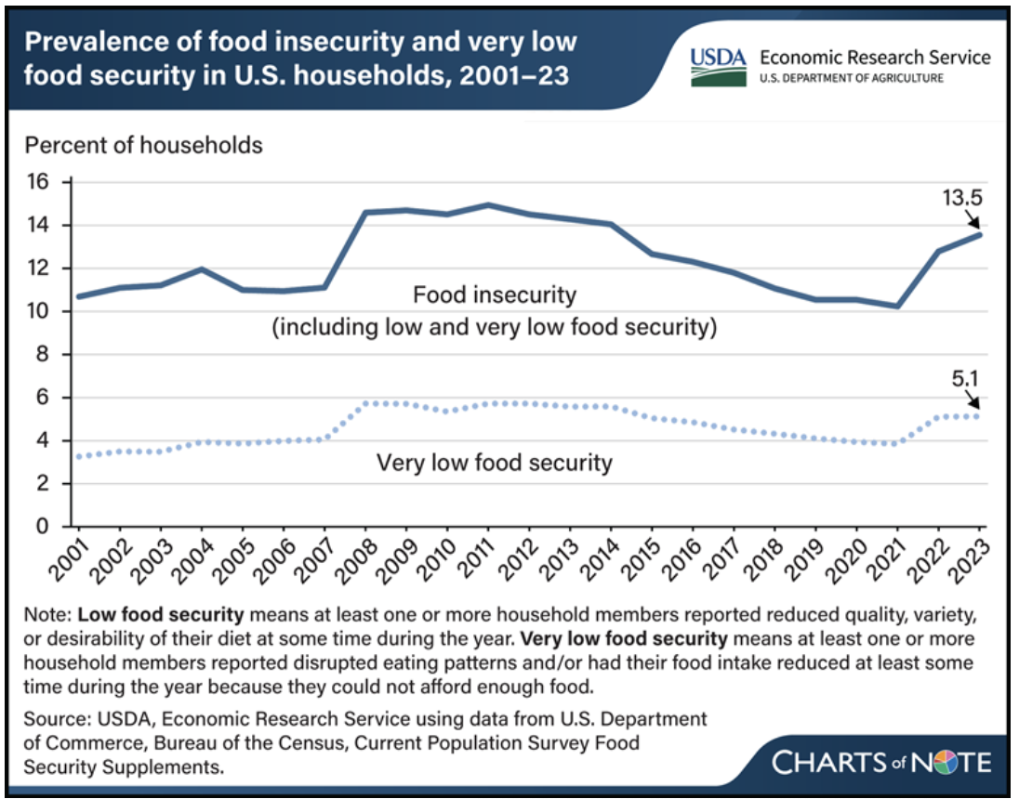
Context: Food Insecurity in America
Source: USDA Economic Research Service (2024)
Notes:
Note: CPS excludes the homeless

Slide 7
Overview: U.S. Food & Nutrition Programs
SNAP - Supplemental Nutrition Assistance Program = “food stamps”
Broad food voucher program for households < 130-200% FPL
$112.8 billion in 2023 (federal), 42.1 million recipients/month (source: USDA ERS)
WIC - Women, Infants, and Children
Voucher for basket of staples (bread, milk, formula, etc.) for pregnant/post-partum women, infants, and children at “nutritional risk”
$6.6 billion in 2023 (federal), 6.6 million participants/month; (source: USDA ERS)
Private charities - food banks/pantries, soup kitchens, etc.
Donations for “human services” charities
$19-28 billion estimated value for 2020 (source: Byrne & Just 2023)

Slide 8
Overview: U.S. School Food Programs
National School Lunch (NSLP) and School Breakfast (SBP) programs
Free or reduced-price meals at school for low-income kids; $17.2 billion for NSLP and $5.2 billion for SBP (federal) (source: USDA ERS)
Community Eligibility Provision – federal funding to allow schools/districts to expand free meals for all students at high-poverty schools
Universal free school meals – state funding to expand free meals to all students at all schools
Pandemic EBT and Summer EBT
Pandemic EBT (2020 – 2023) – temporary food voucher benefit program (like SNAP) to replace free/reduced-price meals lost due to COVID-19 school closures; $28 billion (FY ‘21)
Summer EBT (2024 – Present) – permanent food voucher benefit program (like SNAP) for school-age children in summer months; $2.8 billion (’24 est.)
Notes:
TO UPDATE

Slide 9
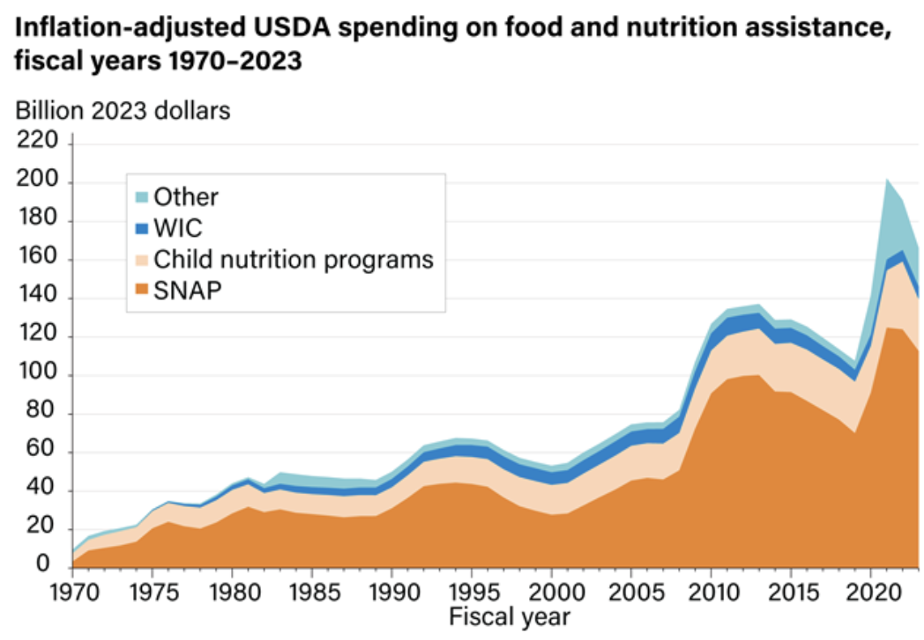
Spending on Food and Nutrition Programs
Large SNAP growth following Great Recession & COVID-19
Benefits co-determined by:
Economic conditions (“automatic stabilizer”)
Policy decisions
Source: USDA ERS (2024)
Notes:
Mention growth of food stamps during recent recession as part of ARRA

Slide 10
Context: How Large is Nutrition Assistance?
Overall food and nutrition assistance is:
2.7 percent of federal spending
Compare: Medicaid = 14.2%
15 percent of U.S. grocery spending (“Food At Home”)
76 percent of Farm Bill spending
≈12+ percent of the population participates
SNAP benefit ≈ 30 percent of recipient income
$297 per month on average in FY 2022
Current debates about SNAP benefit sizes, determined by the Thrifty Food Plan
Notes:
Total federal spending, FY 2023: $6.2 trillion (source: https://usafacts.org/answers/how-much-does-the-us-federal-government-spend/country/united-states/)
Total spending on USDA food and nutrition programs in FY 2023: $166.4 billion (source, same as last slide: https://www.ers.usda.gov/data-products/chart-gallery/chart-detail?chartId=58388#:~:text=Federal%20spending%20on%20USDA's%20food,year%202022%2C%20adjusted%20for%20inflation.)
Total spending on Medicaid: $880 billion https://www.kff.org/medicaid/state-indicator/total-medicaid-spending/?currentTimeframe=0&sortModel=%7B%22colId%22:%22Location%22,%22sort%22:%22asc%22%7D
2023 FAH spending: $1.1 trillion https://www.ers.usda.gov/data-products/chart-gallery/chart-detail?chartId=58364#:~:text=Meanwhile%2C%20food%2Dat%2Dhome,spending%20observed%20in%20the%20series.
Nutrition as a share of the Farm Bill : https://www.ers.usda.gov/topics/farm-economy/farm-commodity-policy/farm-bill-spending#:~:text=The%20Congressional%20Budget%20Office%20(CBO,representing%20nearly%20all%20the%20rest.
SNAP population totals from SNAP Data Tables: https://www.fns.usda.gov/pd/supplemental-nutrition-assistance-program-snap
Avg monthly gross income $969
Avg SNAP benefit amount $297
Source, Table A2: https://fns-prod.azureedge.us/sites/default/files/resource-files/ops-snap-fy22-characteristics.pdf

Slide 11
Two Key Policy Features
Federalism
Federal funding. State/local implement & set detailed rules
Many policy choices left to states, schools
→ programs look very different across place
→ state-level policy experimentation
Social norms, values, and politics
Strong social and political values surrounding food
Influences policy implementation & current debates
Notes:
Implementation details for in-kind programs are key
“Minor” implementation choices can have major impacts
e.g. how to apply or redeem benefits; what to purchase

Slide 12
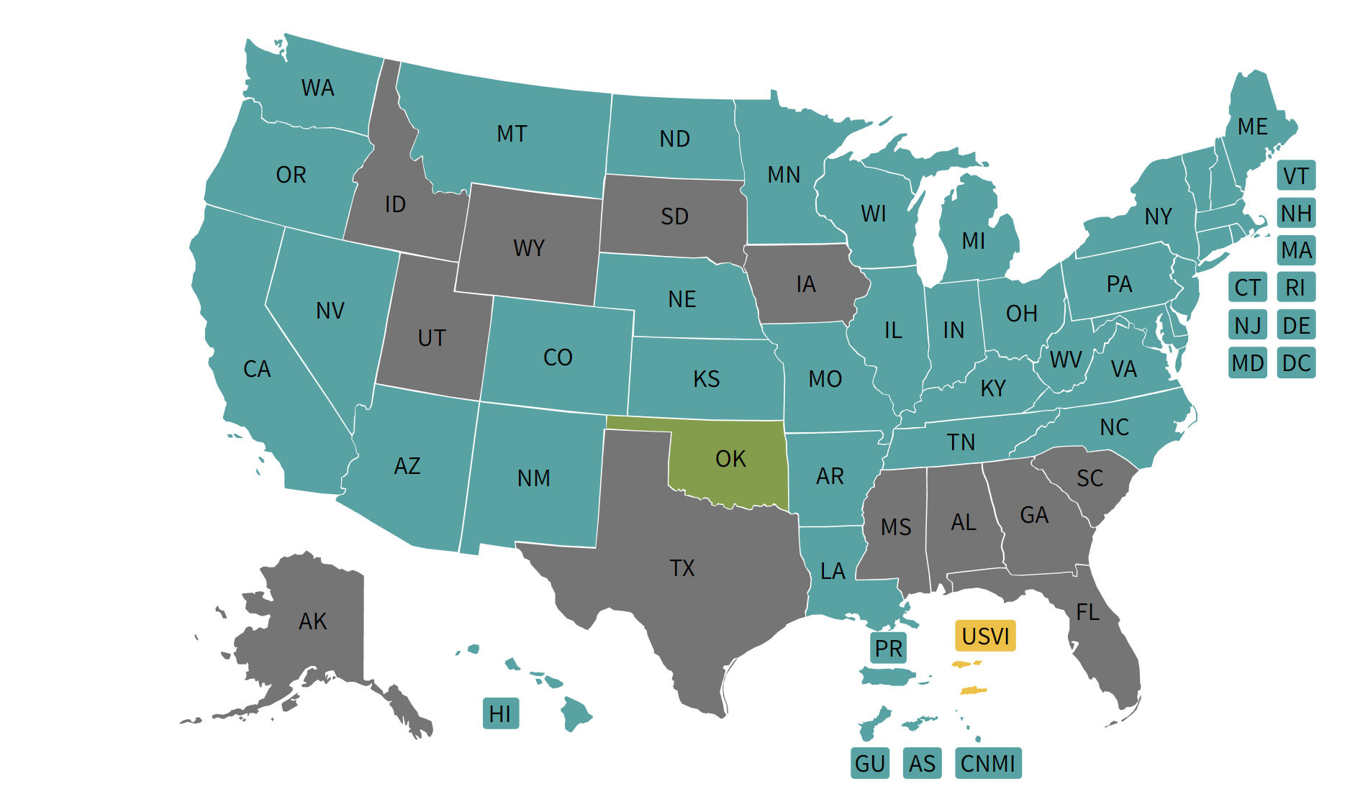
Federalism example: Summer EBT implementation
Yes
No
Yes, in progress
Some tribal nations only
Source: USDA, Sep 2024

Slide 13
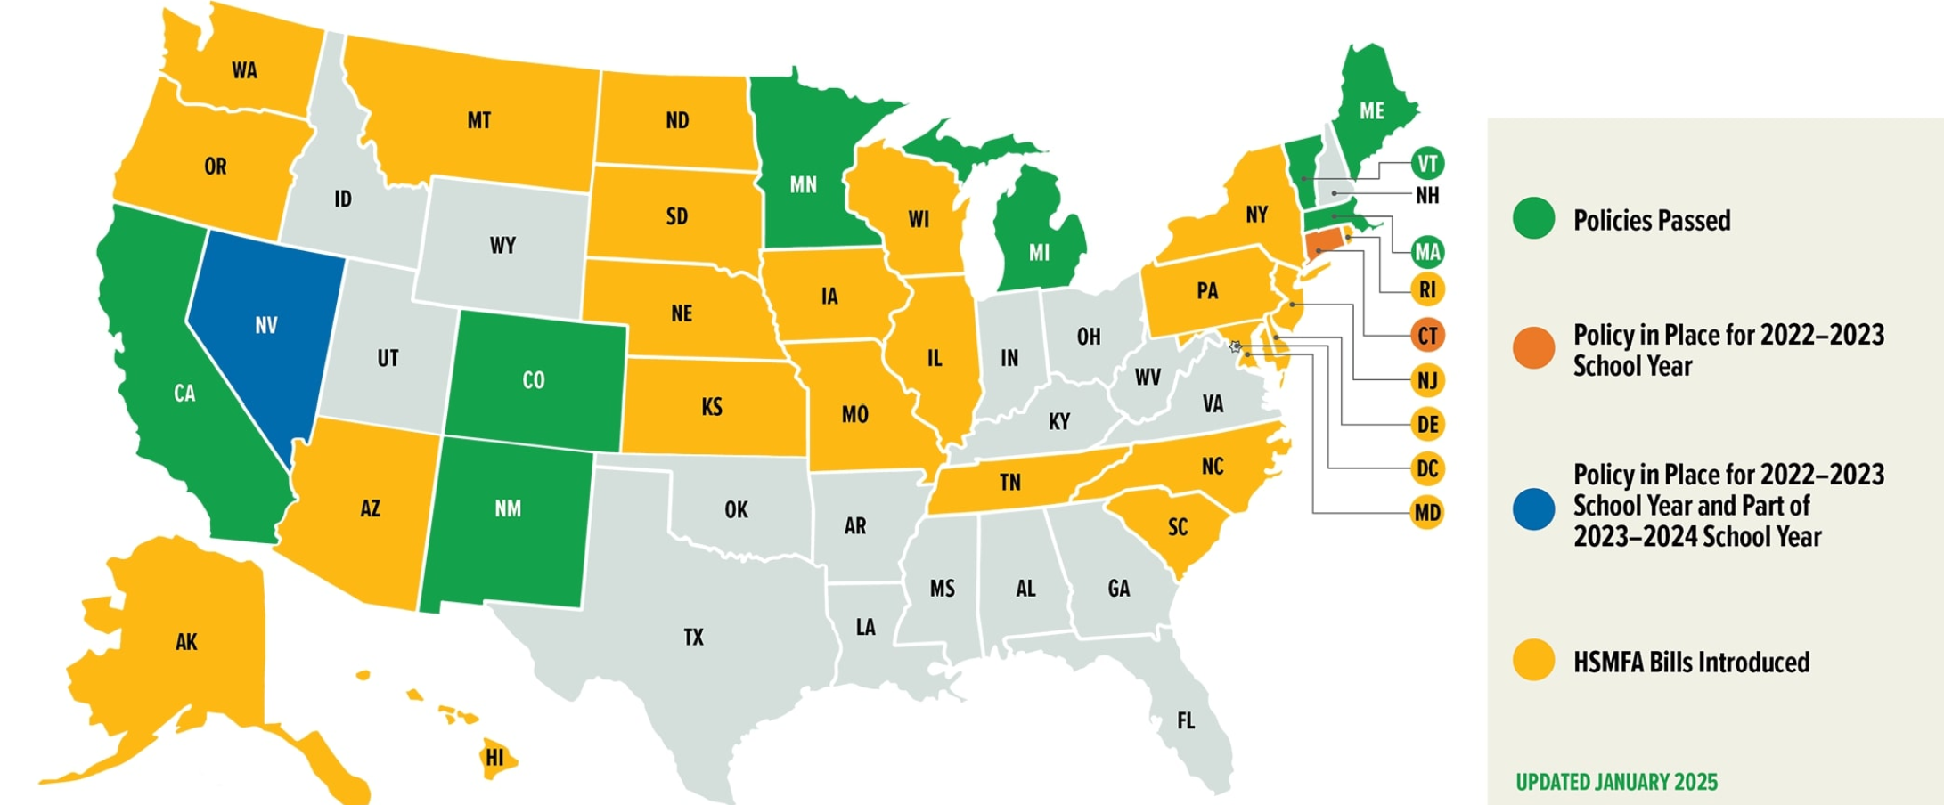
Federalism example: Universal free school meals
All states provided free meals for
SY 2020-21,
2022-23
Source: FRAC
Notes:
Source: https://frac.org/healthy-school-meals-for-all accessed 2024-09-13

Slide 14
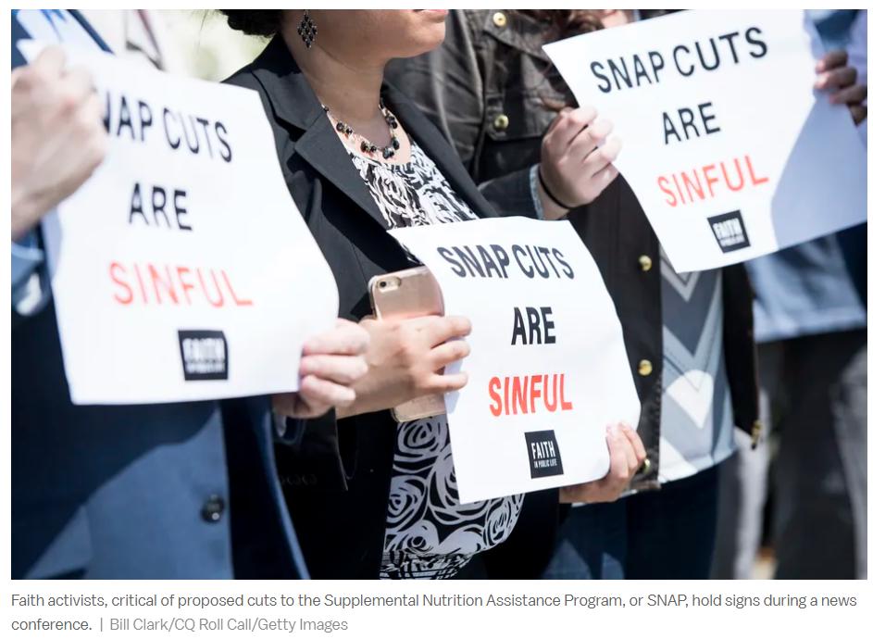

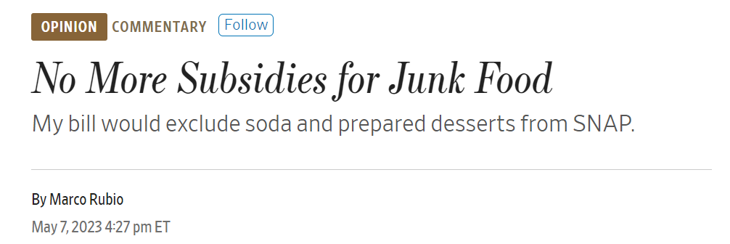
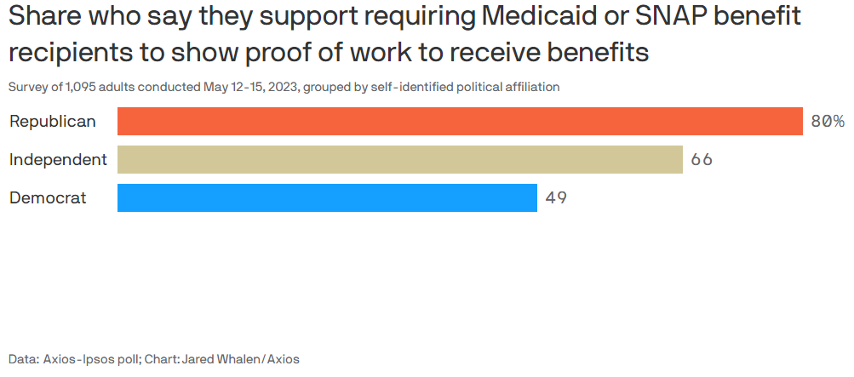
Social norms, values, & politics
Benefit levels
Food purchase restrictions
Work requirements

Slide 15
Three economic features of snap
Section 2.

Slide 16
Three Economic Features of SNAP
Means-tested (NIT-like) benefit schedule
Broad eligibility, but with limits and application hassles
In-kind benefits (food, not cash)

Slide 17
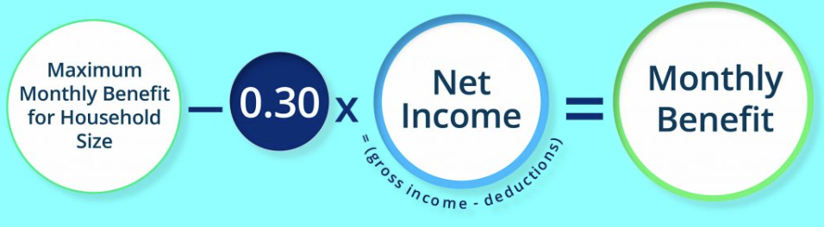
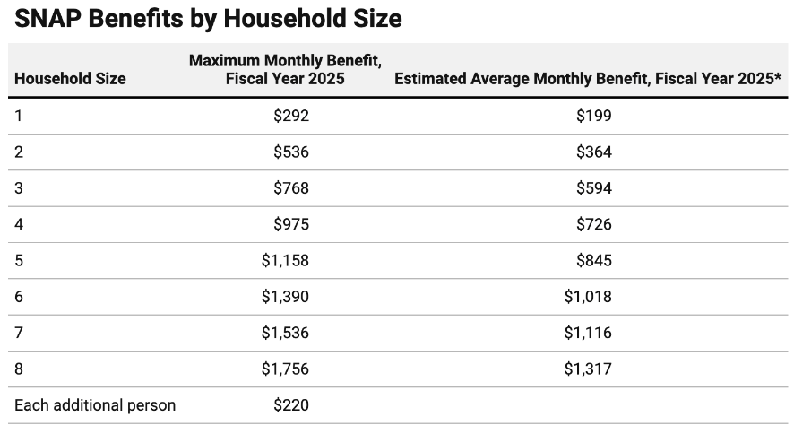



Feature #1: NIT-like Benefit Schedule
Benefit Amount
($)
Max SNAP Benefit (“Thrifty Diet” cost)
$$B^{Max}$$
$$Ben=B^{max}−0.3∗y^{Net}$$
SNAP Benefit
Small benefit cliff at 100% FPL (net income) or 130% FPL (gross income)
100% FPL
Net Income ($y^{net}$)
Sources: MontanaBudget.org, CBPP

Slide 18

Feature #1: NIT-like Benefit Schedule (2)
Take-home Income ($)
Benefit cliff
Earnings + SNAP
Earnings only
Slope (RTW) = $1−t$ $$=0.70$$
Max Ben ($536/month for HH of 2)
Benefit B(y)
130% FPL
Gross Income ($)
Deductions / exemptions
Net Income

Slide 19
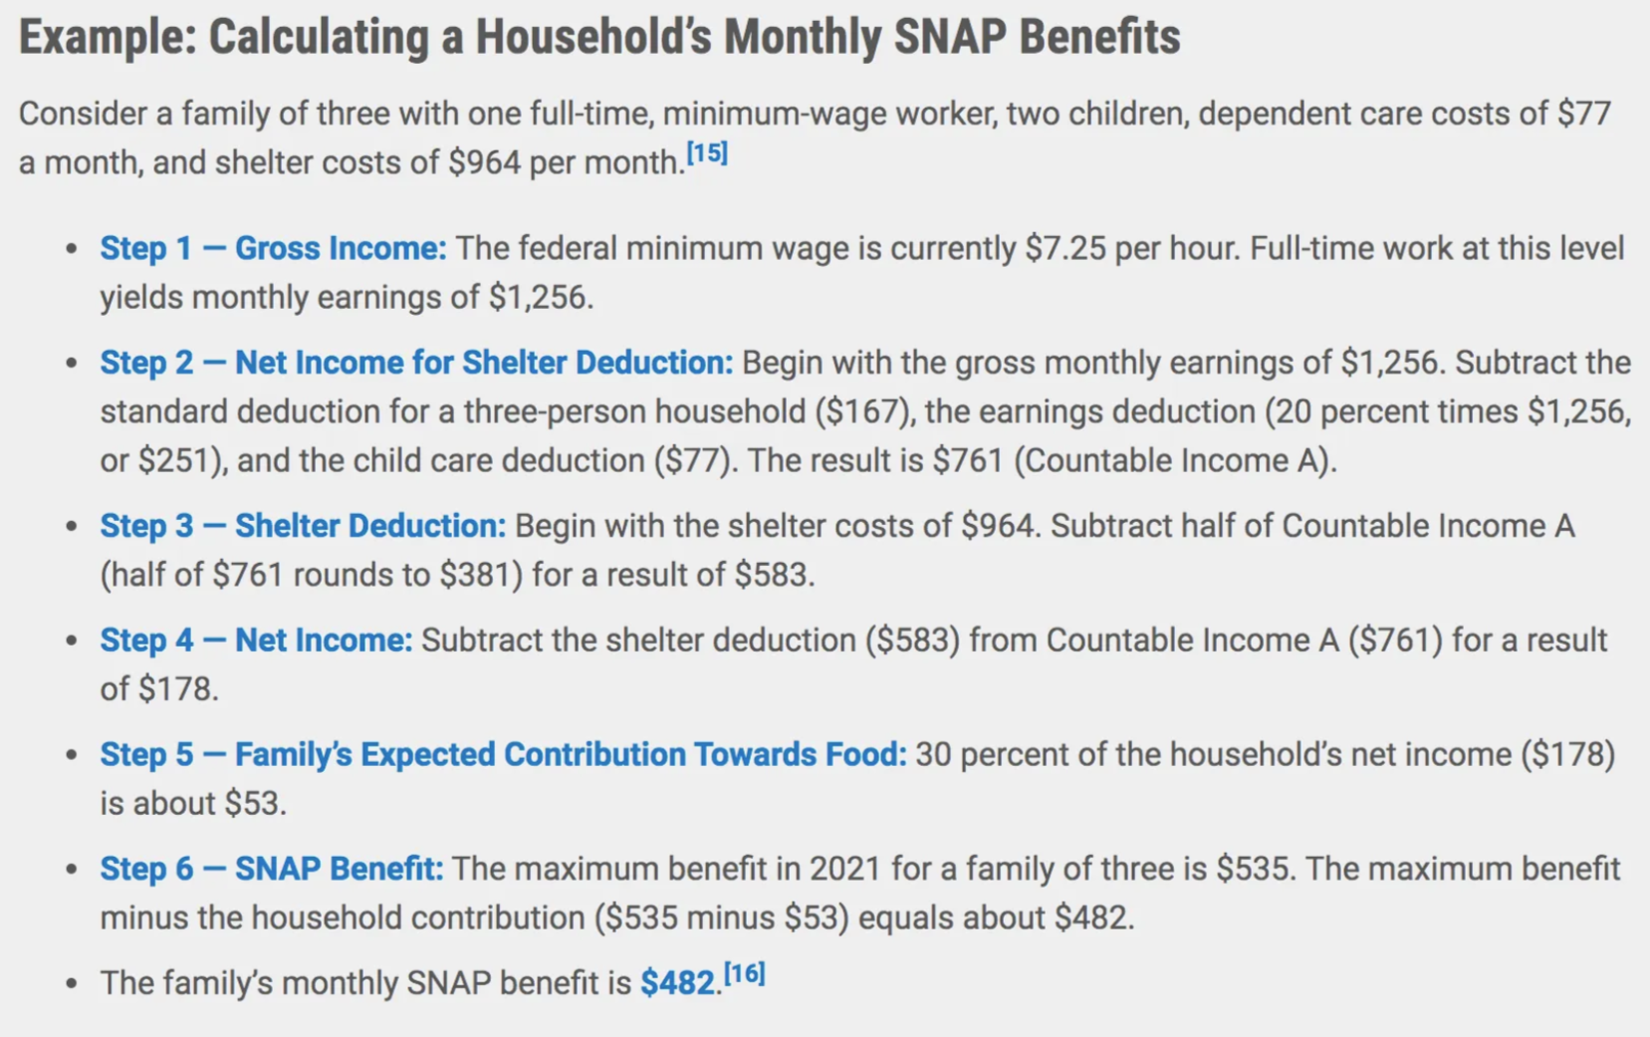
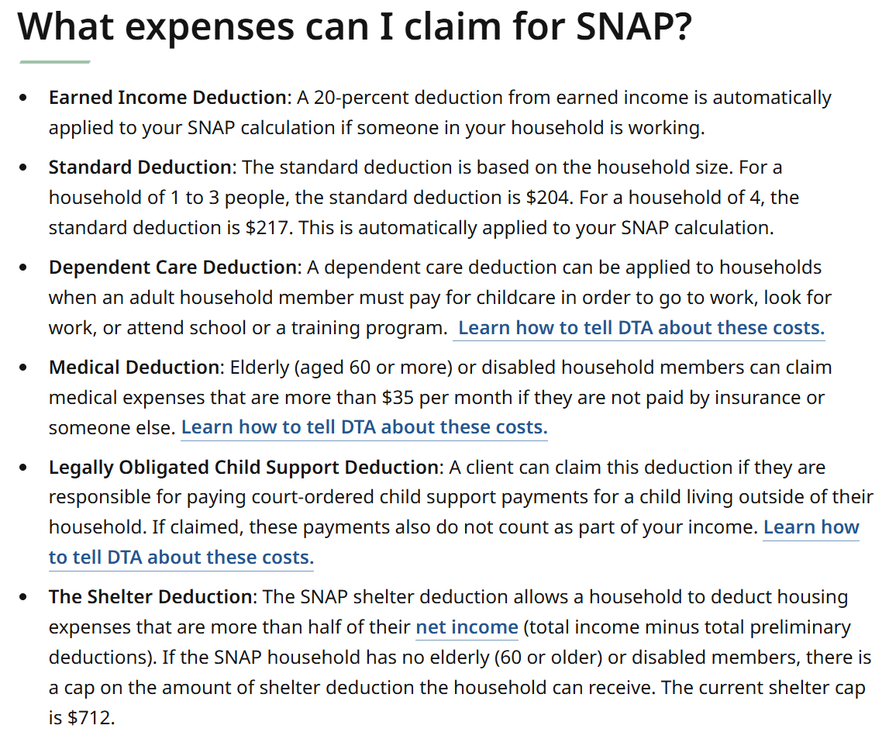
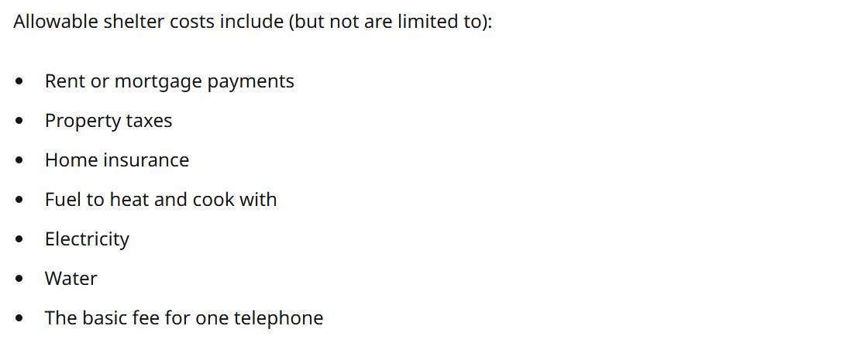
Complexity of Benefit Calculation
Sources: Medium.com, Mass.gov (SNAP rules for Massachusetts)

Slide 20
Feature #2: Broad Eligibility (but with limits and application hassles)
Broad eligibility for low-income families
SNAP has become the safety net program of last resort in America
79 percent of SNAP households included either a child, an elderly, or a disabled individual
Exceptions: Limited eligibility for strikers, college students, adults without dependents, many immigrants (all undocumented and visa holders; permanent residents below “5-year bar”)
Like most safety net programs, SNAP is not automatic
Requires people to actively apply and prove eligibility
Notes:
Sources for participant characteristics: FY 2022 SNAP Households Characteristics https://www.fns.usda.gov/research/snap/characteristics-fy22

Slide 21
Feature #3: In-Kind Benefits
Like other nutrition programs, SNAP is an in-kind benefit
Not cash, but a voucher to purchase grocery food only
Can’t use it for alcohol, tobacco, supplements, or hot prepared foods
250,000+ authorized retailers (grocery, farmer’s markets, and online)
This restricts beneficiaries’ choice set relative to cash benefit programs (like EITC, CTC, TANF)

Slide 22
Feature #3: In-Kind Benefits
Varying degrees of restrictiveness
SNAP, P-EBT, & S-EBT: Flexible food voucher
Implementation: Electronic Benefit Transfer (EBT) cards
2018 Trump admin proposal: “Harvest box”
Nonprofit partnerships like Double Up Food Bucks
WIC: EBT only usable for a basket of staples for mother/infants
Exception: Fruit & vegetable Cash-Value Benefits are similar to SNAP
School meals: On-site food only

Slide 23
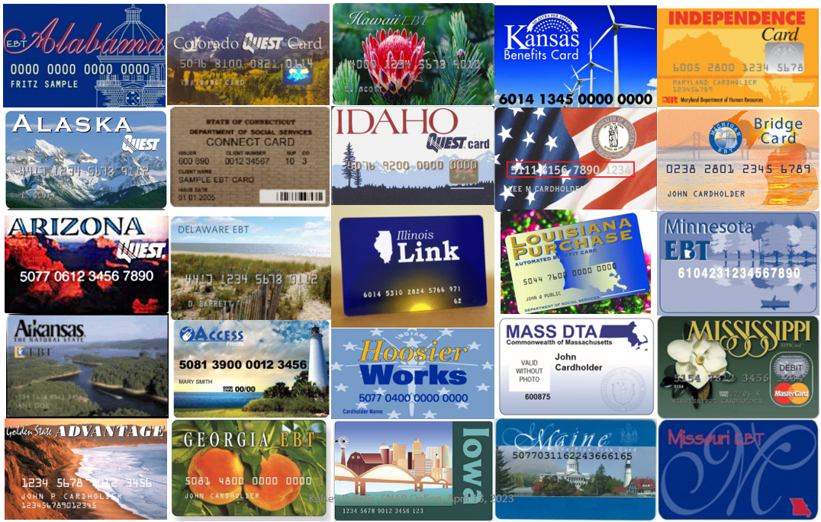
State SNAP EBT Cards

Slide 24

State SNAP EBT Cards (2)

Slide 25
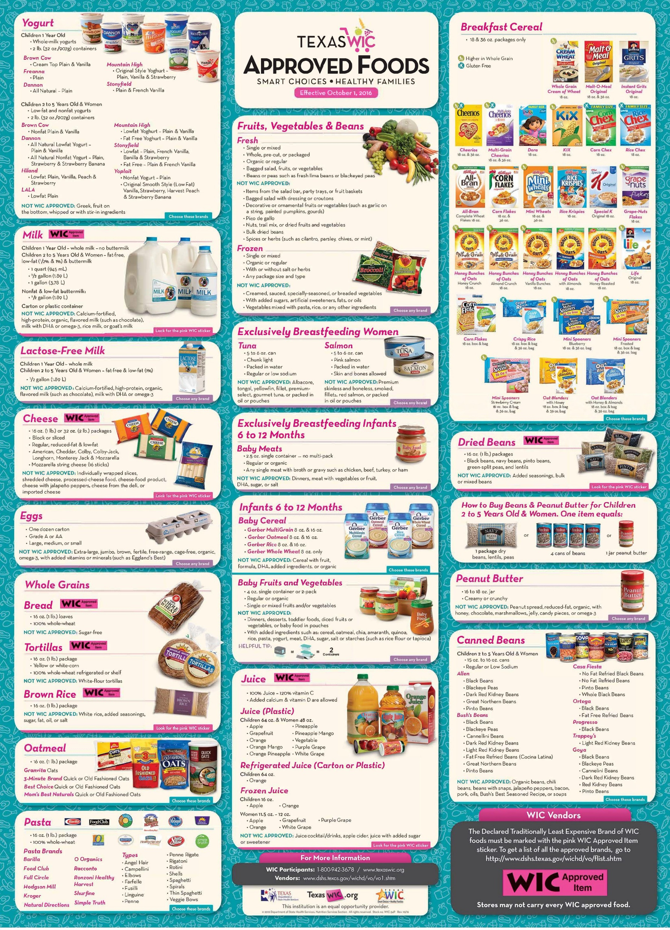
Example of WIC approved foods
Source: Texas DSHS
Notes:
Source: https://x.com/TexasDSHS/status/794989916216233984/photo/1

Slide 26
Why Give In-Kind Benefits?
Econ 101 argument: Cash dominates in-kind benefits
Equal cost to the govt., but cash gives beneficiary more choice, higher utility
In-kind benefits may also involve higher govt. admin costs
What are some potential rationales for in-kind benefits?
Do these justify in-kind benefits like SNAP, or should we be shifting to cash?
Notes:
Some rationales:
Self-targeting: In-kind may be less attractive to not “truly needy” types
Samaritan’s dilemma: Private charities will provide certain in-kind benefits (food, health care) to the poor anyway
Pecuniary externalities: Support a particular market (e.g., affordable housing)
Paternalism (donor preferences): Donors care about ensuring access to a particular good, not necessarily maximizing recipient utility
Particularly relevant when transferring to parents to help children
Behavioral economics: Recipients may be tempted to misuse cash

Slide 27
Is SNAP Equivalent to Cash Anyway?
All other goods
Would be available with cash transfer
SNAP benefit
Budget Set with SNAP
Budget Set w/out SNAP
Marginal consumers (20-30%)
Inframarginal consumers
(70-80%)
Food

Slide 28
New evidence on Nutrition programs
Section 3

Slide 29
Two Studies on Policy-Relevant Topics
Healthy eating subsidies in SNAP
Massachusetts Healthy Incentives Pilot (HIP)
Pilot experiment with RCT (Olsho et al. 2016)
Broader eligibility for school meals
Community Eligibility Provision (CEP)
Marcus and Yewell (2022, Journal of Health Econ)

Slide 30
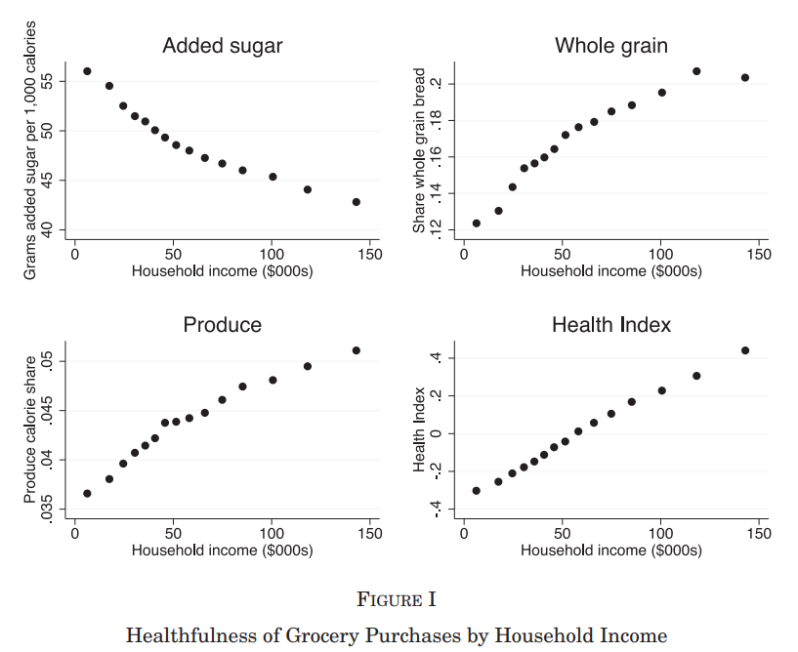
Nutritional inequality by income
“SNAP helps, however, I'm still not eating healthy because I can't afford to.”
-Survey respondent
Source: Allcott et al. (2020). Nielsen Consumer Panel, 2004-2016. Survey responses from Health, Holcomb & Pukelis (2024)

Slide 31
Motivation & background
Policy interest in encouraging healthy eating among SNAP participants
One policy: subsidize the purchase of fruits & vegetables
Healthy Incentives Pilot (HIP) in Hampden County, MA
30% rebate on fruit & vegetable purchases for SNAP participants
Same eligible foods as WIC fruit & vegetable voucher
104 / 474 retailers participated, accounting for 60% of SNAP redemptions
Pilot w/ RCT (Olsho et al. 2016)
Sampling frame: 7,500 treated + 47,595 control SNAP households
Final survey samples: 1,388 treated + 1,396 control
Data collection: Baseline + 2 follow-up surveys
Self-reported dietary intake; some admin benefit redemption data
Notes:
RCT evaluation authorized & funded through ‘08 Farm Bill

Slide 32
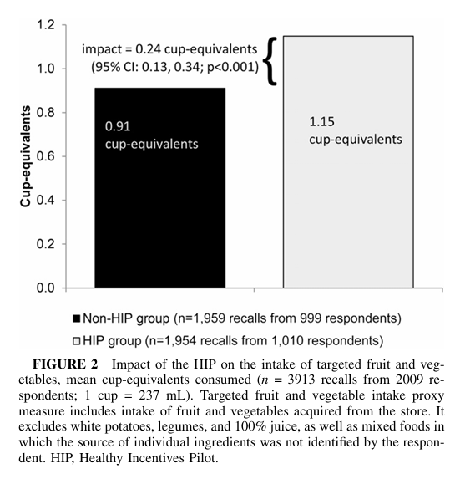
Impact on Targeted Fruit & Vegetable Intake
Recommended level: 3.6 cup-equivalents

Slide 33
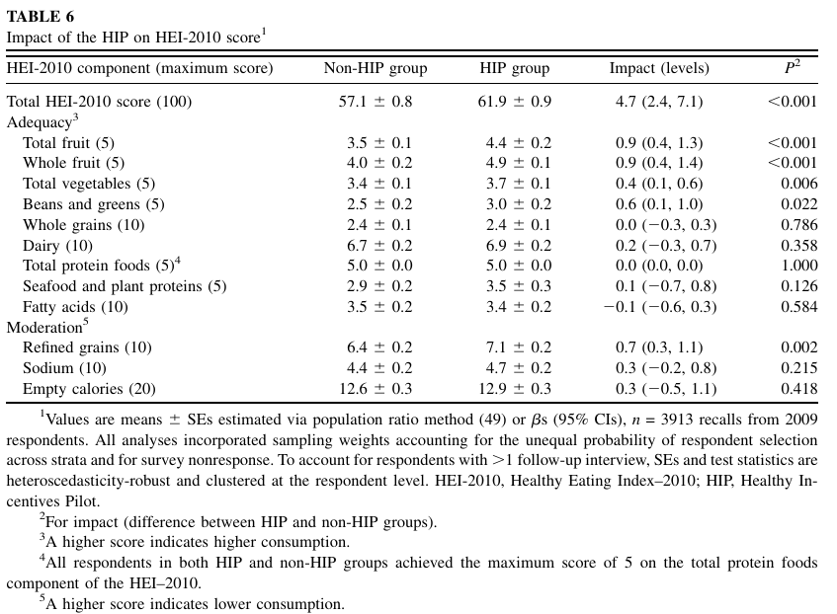
Impacts on Healthy Eating Index
HEI scores are 1.25 points lower among SNAP participants than among SNAP nonparticipants

Slide 34
Summary of Healthy Incentives Pilot
26% ↑ intake of targeted fruits & veggies
Implies a price elasticity of 0.87
↑ intake of some non-targeted fruits & veggies (e.g. 100% fruit juice)
+5 Healthy Eating Index score
Includes ↓ intake of refined grains
More than enough to close 1.25 gap between SNAP & non-SNAP households
Other evidence suggests even small increases are associated with reductions in morbidity & mortality
Effects after incentive removal? Not measured by this study

Slide 35
Healthy Incentives Pilot: Policy Implications
Outreach & awareness: possible confusion over fruit juice eligibility
Retailer participation: requires retailer buy-in & not all participate
Implementation details: direct rebates to EBT cards vs. “mail-in”
>50% implementation costs
Projected costs for nationwide program:
$0.8-$4.5 billion / year – estimated subsidy costs for nationwide HIP
$11 billion / year – estimated subsidy costs to close income nutrition gap (Alcott et al. 2020)
Current policy environment:
Limited federal funding;
Largely state funded, subject to budget cuts (e.g. MA);
Some private funding (e.g. farmers markets)
Notes:
Based on the HIP experience and input from industry experts, the initial start-up costs to expand HIP
nationwide to all 50 States, DC, Guam, and the Virgin Islands is projected to be $89.9 million. This
includes the costs for State agency activities, all EBT and retailer systems modifications, and retailer
and participant training materials. While these would be mainly one-time expenditures, payment of
the HIP incentive to households would be ongoing in a nationwide expansion. The annual value of
incentives earned would depend on participant behaviors that cannot be predicted fully from the pilot.
Estimates of incentives based on plausible scenarios range from $0.8 billion to $4.5 billion annually.

Slide 36
Evidence on school meal programs

Slide 37
Policy Context of School Meal Programs
National School Lunch (NSLP) and School Breakfast (SBP) programs
Provides free, reduced-price, and paid meals at school
USDA reimburses schools for each meal served to cover food, staff, overhead costs, etc.
All meals must meet federal nutrition standards, based on dietary guidelines
Eligibility & take-up
Free: Households income < 130% FPL or receiving SNAP, TANF, FDPIR, Head Start
Reduced: Households incomes between 130% - 185% FPL
For a family of 4, 130% FPL = $40,560 and $185% FPL = $57,720 as of Jul 2024
Incomplete take-up: est. 20-55% of students eligible for free lunch do not participate
Role of stigma & application costs

Slide 38
Community Eligibility Provision (CEP)
CEP allows schools above a certain poverty threshold to expand eligibility for free meals to all students, regardless of family income
Eliminates student applications for free/reduced-price meals
School-level eligibility: Schools where at least 40% of students are eligible for free meals
Student eligibility determined using administrative data on participation in means-tested programs (e.g. SNAP, sometimes Medicaid, etc.)
65% of eligible schools participated in 2019
Threshold decreased in 2023: 40% → 25%

Slide 39
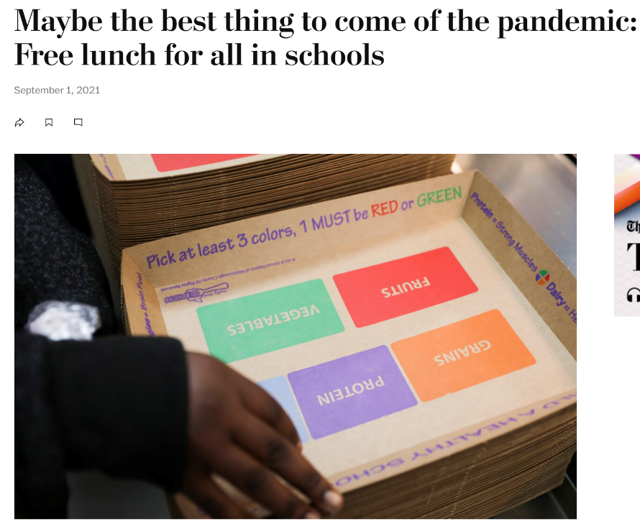

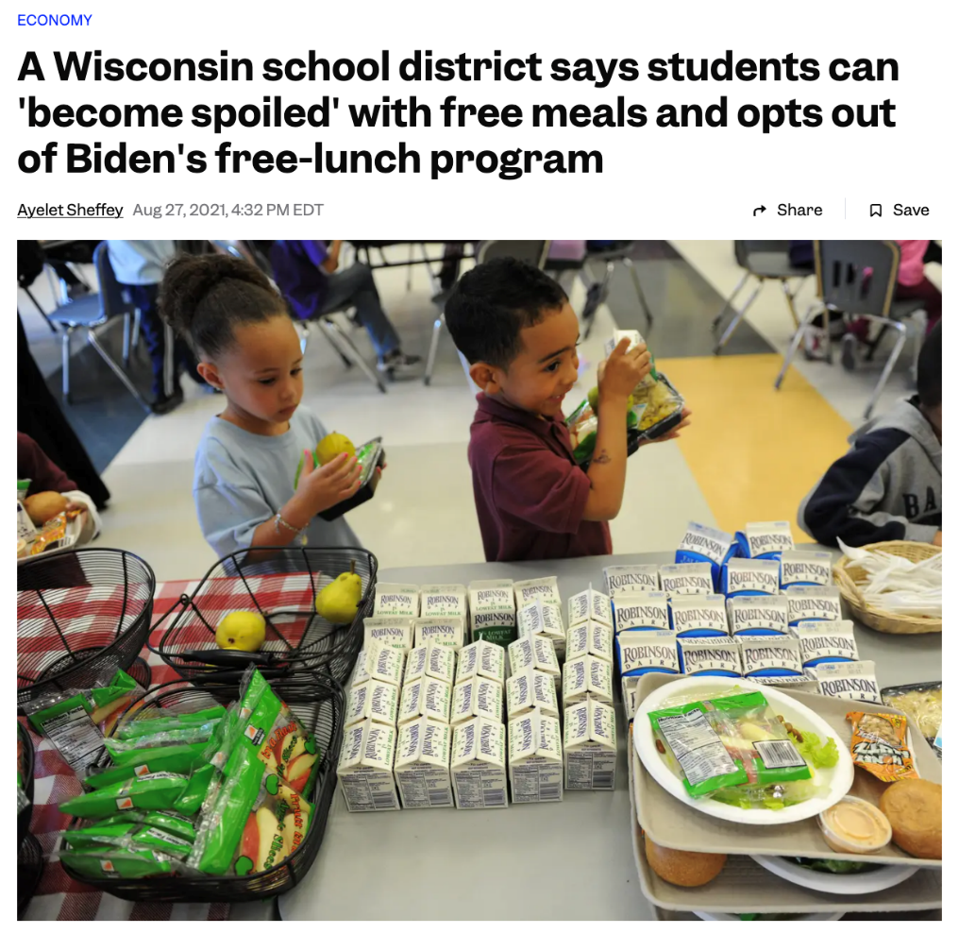
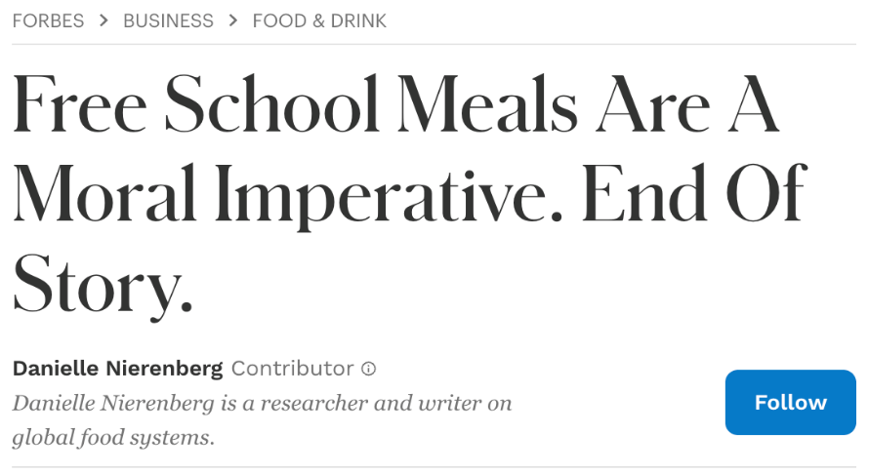
Debates on Universal Free School Meal Policies

Slide 40
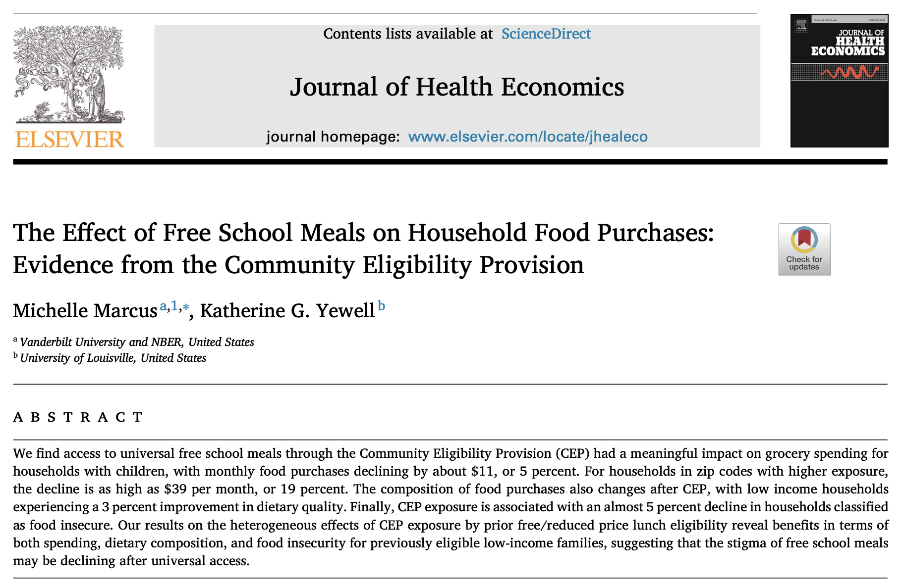
Some Evidence: Marcus and Yewell (2022)
Link to paper

Slide 41
Empirical strategy, outcomes, and data
Triple difference-in-differences empirical strategy
Variation in exposure to CEP-adopting schools across zip codes
Adoption of CEP over time
Comparing households with and without school-age children
Study effects on:
Household grocery spending & dietary quality of food purchased
Using Nielsen Consumer Panel, 2004-2016, zip code level
Note: Measures food purchases, but not intake
Possible mechanisms for affecting dietary quality: (1) through effects on household budgets, which may help households buy healthier foods, or (2) spillovers of school meal dietary guidelines? Study cannot distinguish.
Food insecurity
Using the Current Population Survey Food Security Supplement, 2001-2017

Slide 42
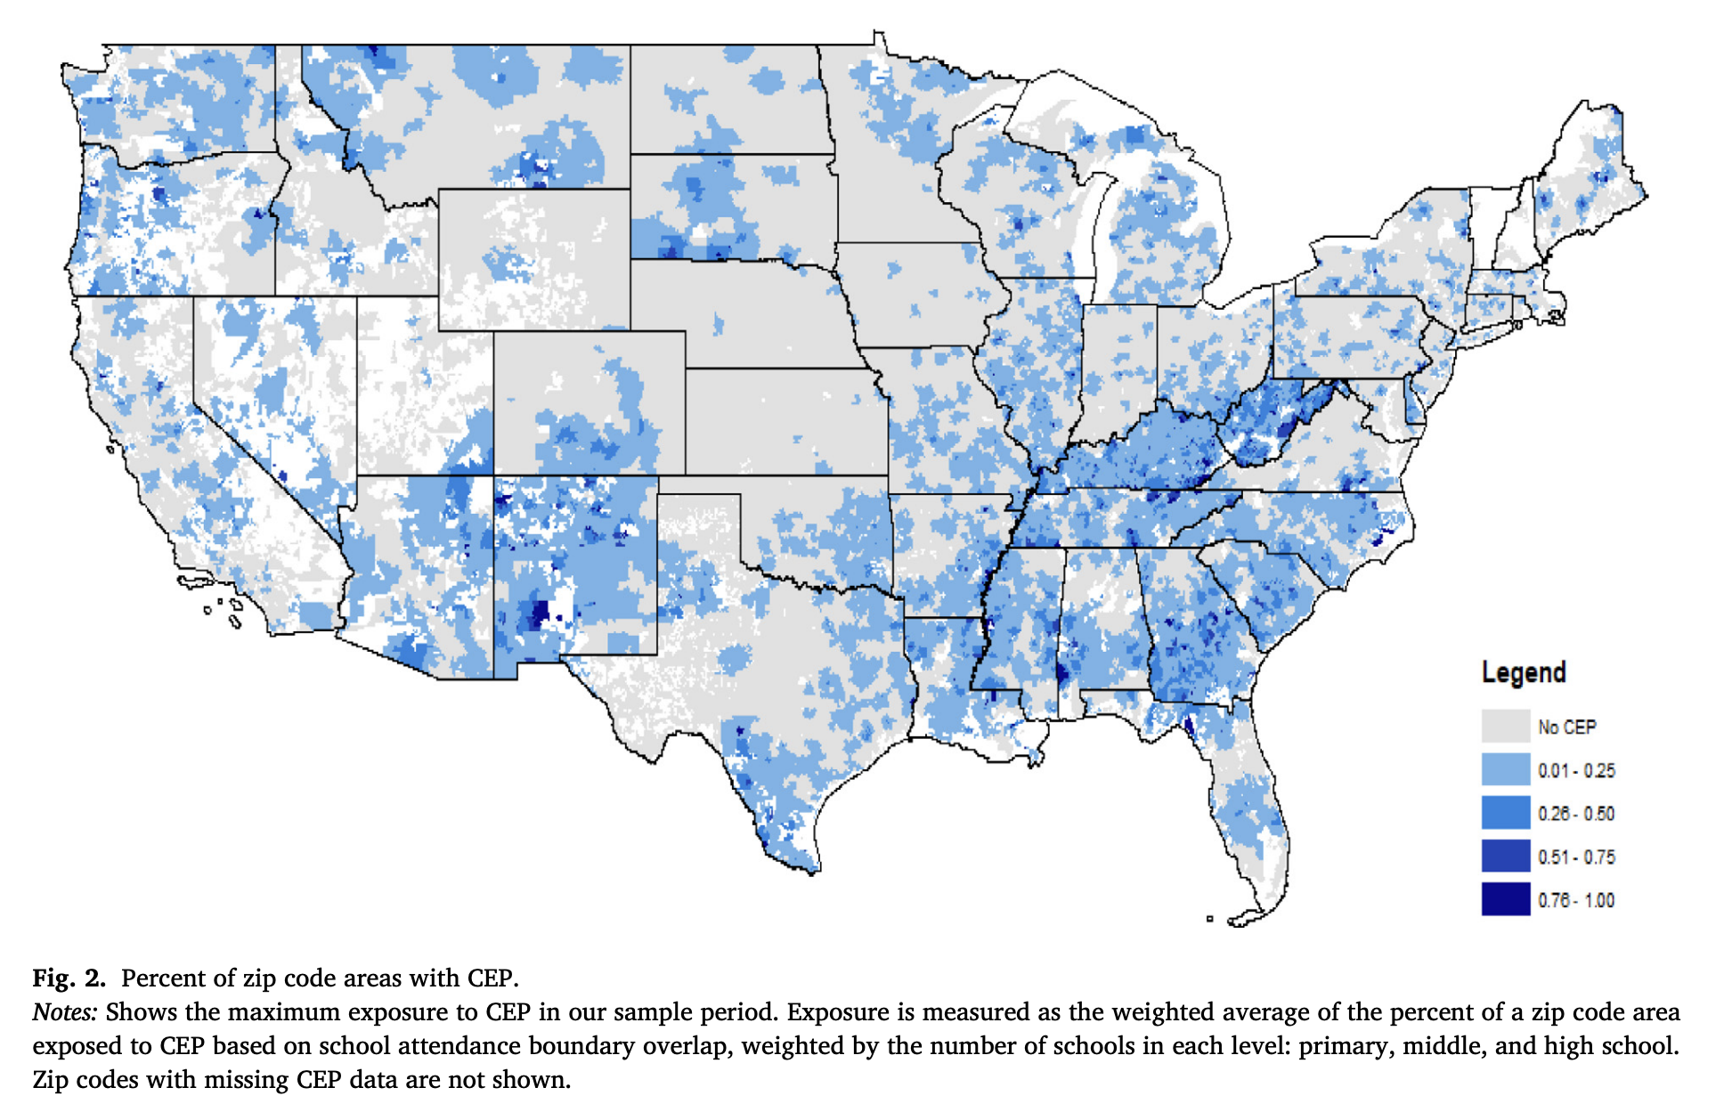
Variation in exposure to CEP across zip codes
The exposure measure reflects the likelihood that a household has a child attending a CEP school, based on its residential zip code and school attendance boundaries.

Slide 43
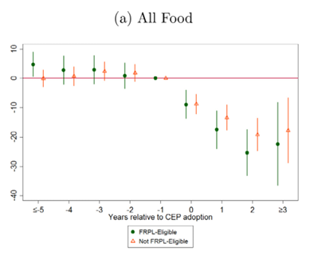
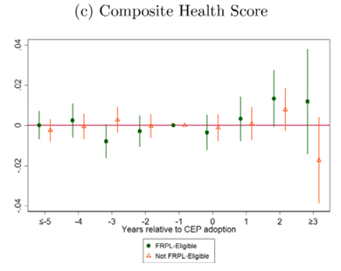
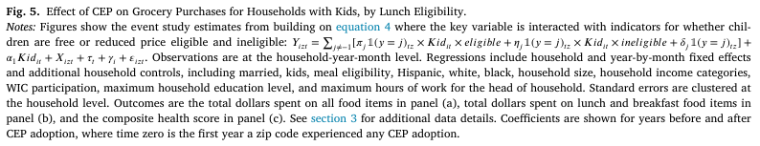
Effects on food spending & diet quality
FRPL-Eligible = Free / Reduced-Price Eligible

Slide 44
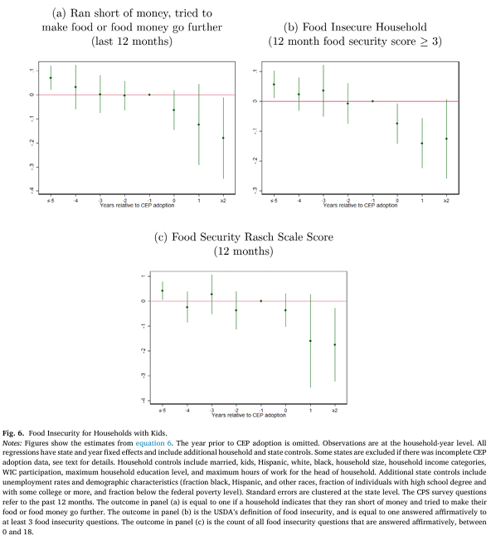
Effects on Food Insecurity

Slide 45
Effects of CEP from Marcus and Yewell (2022)
Decreased household monthly food purchases by $11 (5%)
Suggestive evidence that CEP improved dietary quality of foods purchased by 3% among low-income households
No change for the average household
Reduced the num. food insecure households by ≈5%
Likely positive spillovers to family members of CEP-affected children
Similar effects across those previously and newly eligible for free/reduced-price meals
Suggests that CEP helped address enrollment frictions in free/reduced-price meals for eligible low-income families, such as stigma and application costs
Notes:
9% decrease among common breakfast and lunch foods

Slide 46
Policy Take-aways
For the debate on universal school lunches:
Positive short-run impacts on nutrition & food security
Effects may translate into later-life impacts on health, earnings, and education – the safety net as a long-run investment in children
For broader debates on targeted vs. universal welfare programs:
Policymakers face a tradeoff between targeting benefits to those who may need them more, and associated application costs which can reduce take-up
Esp. in settings with low take-up, expanding access and reducing application costs can increase participation among already-eligible groups

